Slide 1
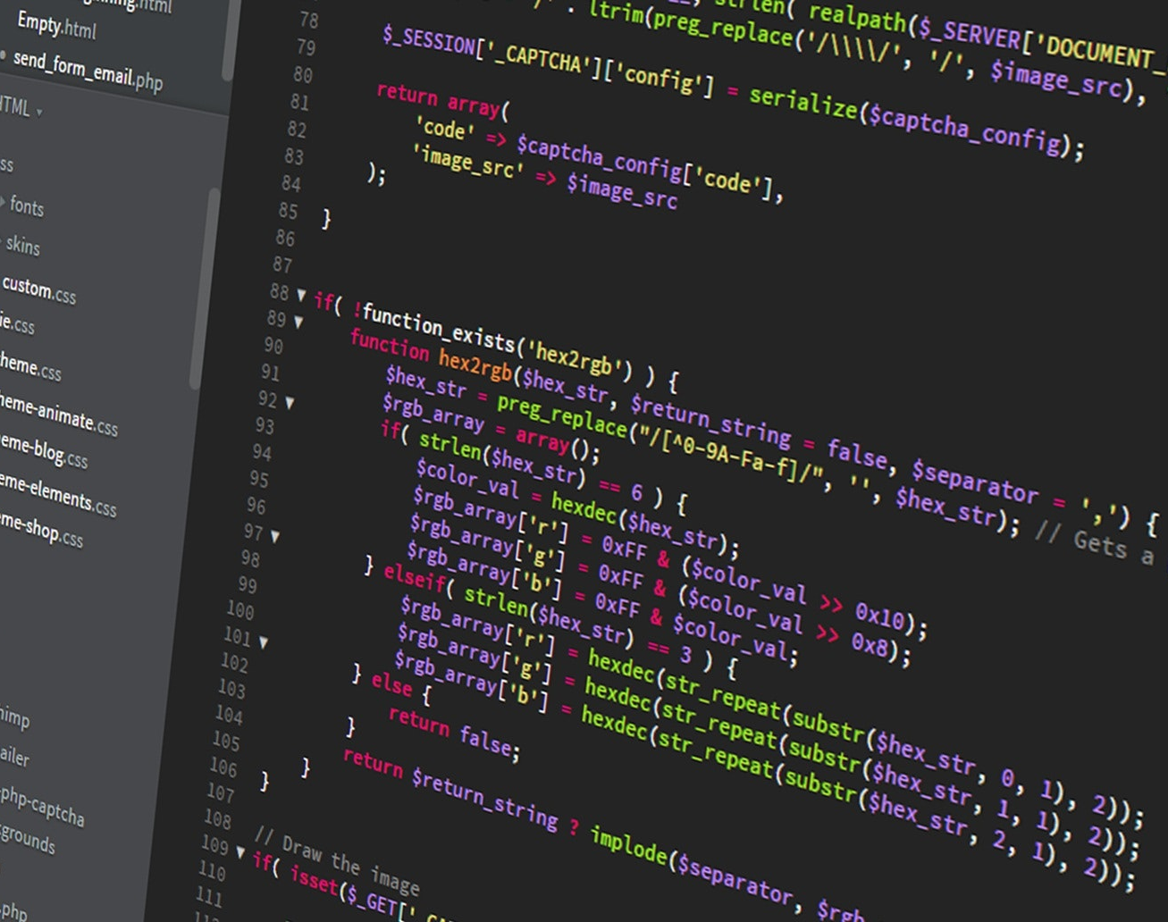
ICT 101 Introduction to the Internet and Web Development
Week 10 Lectorial
Courtesy of Pixabay

Slide 2
Weekly Learning Goals
Read Chapter 37-39 of The Prescribed Text
Attend Lectorial
Perform practical tasks

Slide 3

Week 10 Learning Outcomes
By the end of this week, you should be able to demonstrate:
Understanding forms validation in PHP
An understanding of basic database types
The ability to create, populate, and interact with a MySQL database

Slide 4
Week 10 Lab Preparation
Goal
Students will learn how to create a database in XAMPP/phpMyAdmin, create related tables, choose primary and foreign keys, draw an ERD, and write simple SQL queries.

Slide 5
Week 10 Lab Preparation
Step 1: Start XAMPP
Open XAMPP Control Panel.
Start:
Apache
MySQL
Open browser and go to:
http://localhost/phpmyadmin

Slide 6
Week 10 Lab Preparation
Step 2: Create the Database
In phpMyAdmin:
Click New.
Database name:
cars_customers
Avoid using & in database names because it can cause issues. Use underscore instead.
3. Click Create.

Slide 7
Week 10 Lab Preparation
Step 3: Create the Customers Table
Use this SQL:
CREATE TABLE customers ( customer_id INT AUTO_INCREMENT PRIMARY KEY, first_name VARCHAR(50) NOT NULL, last_name VARCHAR(50) NOT NULL, licence_number VARCHAR(30) NOT NULL UNIQUE, date_of_birth DATE, time_of_registration DATETIME DEFAULT CURRENT_TIMESTAMP );

Slide 8
Week 10 Lab Preparation
Explanation
customer_id is the Primary Key.
licence_number is unique because two customers should not have the same licence number.
time_of_registration records when the customer was registered.

Slide 9
Week 10 Lab Preparation
Step 4: Create the Cars Table
CREATE TABLE cars ( car_id INT AUTO_INCREMENT PRIMARY KEY, car_make_model VARCHAR(100) NOT NULL, car_color VARCHAR(30) NOT NULL, rental_price_per_day DECIMAL(10,2) NOT NULL, booking_status VARCHAR(20) NOT NULL );
Example booking status values
Booked Not Booked

Slide 10
Week 10 Lab Preparation
Step 5: Create a Booking Table for the Foreign Key
A car can be booked by a customer, so we need a separate table to connect customers and cars.
CREATE TABLE bookings ( booking_id INT AUTO_INCREMENT PRIMARY KEY, customer_id INT NOT NULL, car_id INT NOT NULL, booking_date DATE DEFAULT CURRENT_DATE, FOREIGN KEY (customer_id) REFERENCES customers(customer_id), FOREIGN KEY (car_id) REFERENCES cars(car_id) );

Slide 11
Week 10 Lab Preparation
Why use a booking table?
This is better database design because:
One customer may book many cars over time.
One car may be booked many times by different customers.
The bookings table stores the relationship.

Slide 12
Week 10 Lab Preparation
Step 6: Insert Sample Data
Customers
INSERT INTO customers (first_name, last_name, licence_number, date_of_birth) VALUES ('Ali', 'Khan', 'LIC12345', '1998-05-12'), ('Sarah', 'Smith', 'LIC67890', '2000-09-20'), ('John', 'Brown', 'LIC54321', '1995-03-15');

Slide 13
Week 10 Lab Preparation
Cars
INSERT INTO cars (car_make_model, car_color, rental_price_per_day, booking_status) VALUES ('Toyota Corolla', 'Blue', 60.00, 'Booked'), ('Honda Civic', 'Red', 70.00, 'Not Booked'), ('Mazda 3', 'Blue', 65.00, 'Booked');

Slide 14
Week 10 Lab Preparation
Bookings
INSERT INTO bookings (customer_id, car_id) VALUES (1, 1), (2, 3);

Slide 15
Week 10 Lab Preparation
Step 7: Primary Keys and Foreign Keys
Primary Keys
Table | Primary Key
customers | customer_id
cars | car_id
bookings | booking_id

Slide 16
Week 10 Lab Preparation
Foreign Keys
Table | Foreign Key | References
bookings | customer_id | customers(customer_id)
bookings | car_id | cars(car_id)

Slide 17
Week 10 Lab Preparation
Step 8: ERD Relationship Explanation
Relationship
Customer 1 ——< Booking >—— 1 Car
In words
One customer can make many bookings.
One car can appear in many bookings over time.
Each booking belongs to one customer.
Each booking is for one car.

Slide 18
Week 10 Lab Preparation
Crow’s Foot Notation
CUSTOMERS || ——< BOOKINGS >—— || CARS
Students can draw this using:
draw.io
Lucidchart
Word shapes
PowerPoint shapes

Slide 19
Week 10 Lab Preparation
Step 9: SQL Query Reports
a. List of cars that are blue in color
SELECT * FROM cars WHERE car_color = 'Blue';

Slide 20
Week 10 Lab Preparation
b. List customer names and licence numbers who have a booking
SELECT customers.first_name, customers.last_name, customers.licence_number FROM customers INNER JOIN bookings ON customers.customer_id = bookings.customer_id;

Slide 21
Week 10 Lab Preparation
Optional improved version showing car details:
SELECT customers.first_name, customers.last_name, customers.licence_number, cars.car_make_model, cars.car_color FROM customers INNER JOIN bookings ON customers.customer_id = bookings.customer_id INNER JOIN cars ON bookings.car_id = cars.car_id;

Slide 22
Week 10 Lab Preparation
Step 10: What Students Should Submit
Students should create a Word document named:
Week 10.doc
The document should include:
Database name
SQL code for creating tables
Screenshot of phpMyAdmin tables
Screenshot of inserted records
Screenshot of query results
ERD diagram using Crow’s Foot notation
Short explanation of primary keys, foreign keys, and relationships

Slide 23
Week 10 Lab Preparation
Complete the Activity in this order:
Database → Tables → Primary Keys → Foreign Keys → Sample Data → SQL Queries → ERD → Screenshots → Submit

Slide 24
Today’s Webinar
Form Validation in PHP
Basics of Databases
MYSQL
Creating Database, Tables
Insert, Update, Delete data into Tables

Slide 25
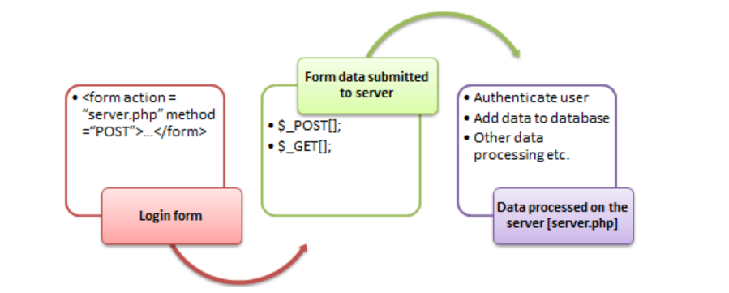
PHP Form Handling

Slide 26
Submitting the Form Data to the Server
POST
GET
Both GET and POST create an array (e.g. array( key1 => value1, key2 => value2, key3 => value3, ...)).
This array holds key/value pairs, where keys are the names of the form controls and values are the input data from the user.

Slide 27
POST Method
This is the built in PHP super global array variable that is used to get values submitted via HTTP POST method.
The array variable can be accessed from any script in the program.
This method is ideal when you do not want to display the form post values in the URL.
A good example of using post method is when submitting login details to the server.
<?php
$_POST['variable_name'];
?>
https://www.w3schools.com

Slide 28
GET Method
This is the built in PHP super global array variable that is used to get values submitted via HTTP GET method.
The array variable can be accessed from any script in the program.
This method displays the form values in the URL.
It’s ideal for search engine forms.
<?php
$_GET['variable_name'];
?>
https://www.w3schools.com

Slide 29
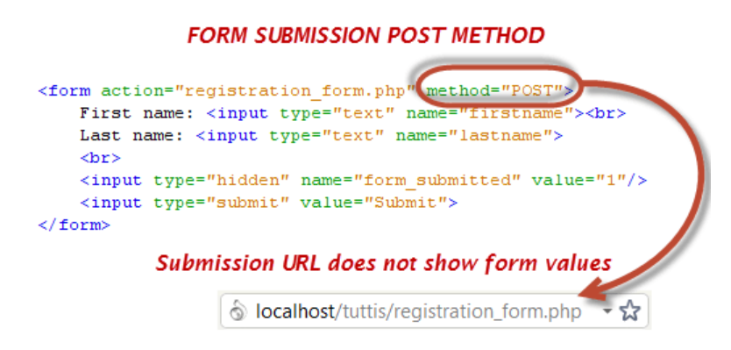
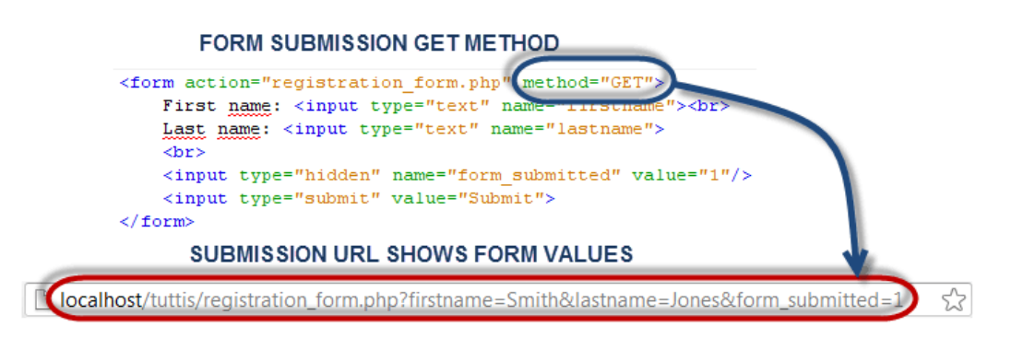
GET and POST

Slide 30
GET and POST

Slide 31
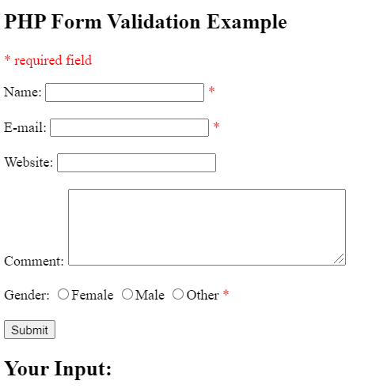
Form Validation in PHP

Slide 32
Solution
<!DOCTYPE HTML>
<html>
<head>
</head>
<body>
<?php
// define variables and set to empty values
$name = $email = $gender = $comment = $website = "";
if ($_SERVER["REQUEST_METHOD"] == "POST") {
$name = test_input($_POST["name"]);
$email = test_input($_POST["email"]);
$website = test_input($_POST["website"]);
$comment = test_input($_POST["comment"]);
$gender = test_input($_POST["gender"]);
}function test_input($data) {
$data = trim($data);//whitespace stripped from the beginning and end of string
$data = stripslashes($data);//Returns a string with backslashes stripped off
return $data;}?>

Slide 33
Solution
<h2>PHP Form Validation Example</h2>
<form method="post" action="">
Name: <input type="text" name="name">
<br><br>
E-mail: <input type="text" name="email">
<br><br>
Website: <input type="text" name="website">
<br><br>
Comment: <textarea name="comment" rows="5" cols="40"></textarea>
<br><br> Gender:
<input type="radio" name="gender" value="female">Female
<input type="radio" name="gender" value="male">Male
<input type="radio" name="gender" value="other">Other
<br><br>
<input type="submit" name="submit" value="Submit">
</form
><?php
echo "<h2>Your Input:</h2>";
echo $name;
echo "<br>";
echo $email;
echo "<br>";
echo $website;
echo "<br>";
echo $comment;
echo "<br>";
echo $gender;
?>
</body>
</html>

Slide 34
Adding Validation of Name and Email
<!DOCTYPE HTML>
<html>
<head>
<style>
.error {color: #FF0000;}
</style>
</head>
<body>
<?php
// define variables and set to empty values
$nameErr = $emailErr = $genderErr = $websiteErr = "";
$name = $email = $gender = $comment = $website = "";
if ($_SERVER["REQUEST_METHOD"] == "POST") {
if (empty($_POST["name"])) {
$nameErr = "Name is required";
} else {
$name = test_input($_POST["name"]);
// check if name only contains letters and whitespace
if (!preg_match("/^[a-zA-Z-' ]*$/",$name)) {
$nameErr = "Only letters and white space allowed";
}
}
if (empty($_POST["email"])) {
$emailErr = "Email is required";
} else {
$email = test_input($_POST["email"]);
// check if e-mail address is well-formed
if (!filter_var($email, FILTER_VALIDATE_EMAIL)) {
$emailErr = "Invalid email format";
}
}
function test_input($data) {
$data = trim($data);
$data = stripslashes($data);
$data = htmlspecialchars($data);
return $data;
}?>

Slide 35
Working with Databases

Slide 36
What is a Database?
Data:
Data is any fact or information related to object of interest e.g. age, height, grade
Database:
Database is a systematic way of storing data for future use.
Normally database is taught as an entire course. Here we will have a brief overview

Slide 37
Database and Web Development

Slide 38
Database Design
A database is composed of one or more tables.
A table is the principal unit of storage in a database.
Each table in a database is generally modeled after some type of real-world entity, such as a customer or a product.
A table is a two-dimensional container for data that consists of records (rows); each record has the same number of columns, which are more specifically called fields, which contain the actual data.
Each table will have one special field called a primary key that is used to uniquely identify each record in a table.

Slide 39
Database Design

Slide 40
Representation of Table

Slide 41
Linking of Tables
A FOREIGN KEY is a key used to link two tables together.
A FOREIGN KEY is a field (or collection of fields) in one table that refers to the PRIMARY KEY in another table.
The FOREIGN KEY prevents invalid data from being inserted into the foreign key column
Because it has to be one of the values contained in the table it points to.

Slide 42
SQL
SQL stands for Structured Query Language.
It can be used to manipulate the database.
The Data Manipulation Language (DML) features of SQL include SELECT, UPDATE, INSERT and DELETE
The Data Definition Language (DDL) in SQL is used to create tables, modifying the structure of a table, deleting tables, and creating and deleting databases

Slide 43
What can SQL do?
SQL can execute queries against a database
SQL can retrieve data from a database
SQL can insert records in a database
SQL can update records in a database
SQL can delete records from a database
SQL can create new databases
SQL can create new tables in a database

Slide 44
Data Retrieval
To retrieve data from database we can use SQL select statement

Slide 45
Data Retrieval

Slide 46
Inserting Data

Slide 47
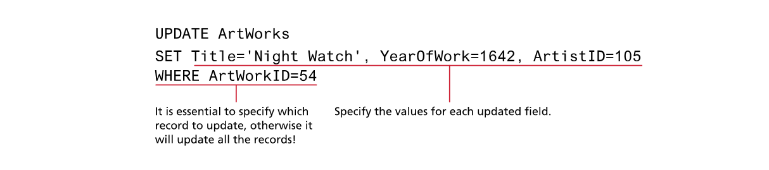
Update Data

Slide 48
Delete Data

Slide 49
MYSQL
MySQL is a database system used on the web
MySQL is a database system that runs on a server
MySQL is ideal for both small and large applications
MySQL is very fast, reliable, and easy to use
MySQL uses SQL
MySQL compiles on a number of platforms
MySQL is free to download and use
MySQL is developed, distributed, and supported by Oracle Corporation

Slide 50
Database APIs
PHP 5 and later work with MySQL database using
MySQLi extension
PHP Data Objects (PDO)
We will be using MYSQLi extension
This extension provides both a procedural and an object-oriented approach.
We will use the procedural approach.
This extension also supports most of the latest features of MySQL.

Slide 51
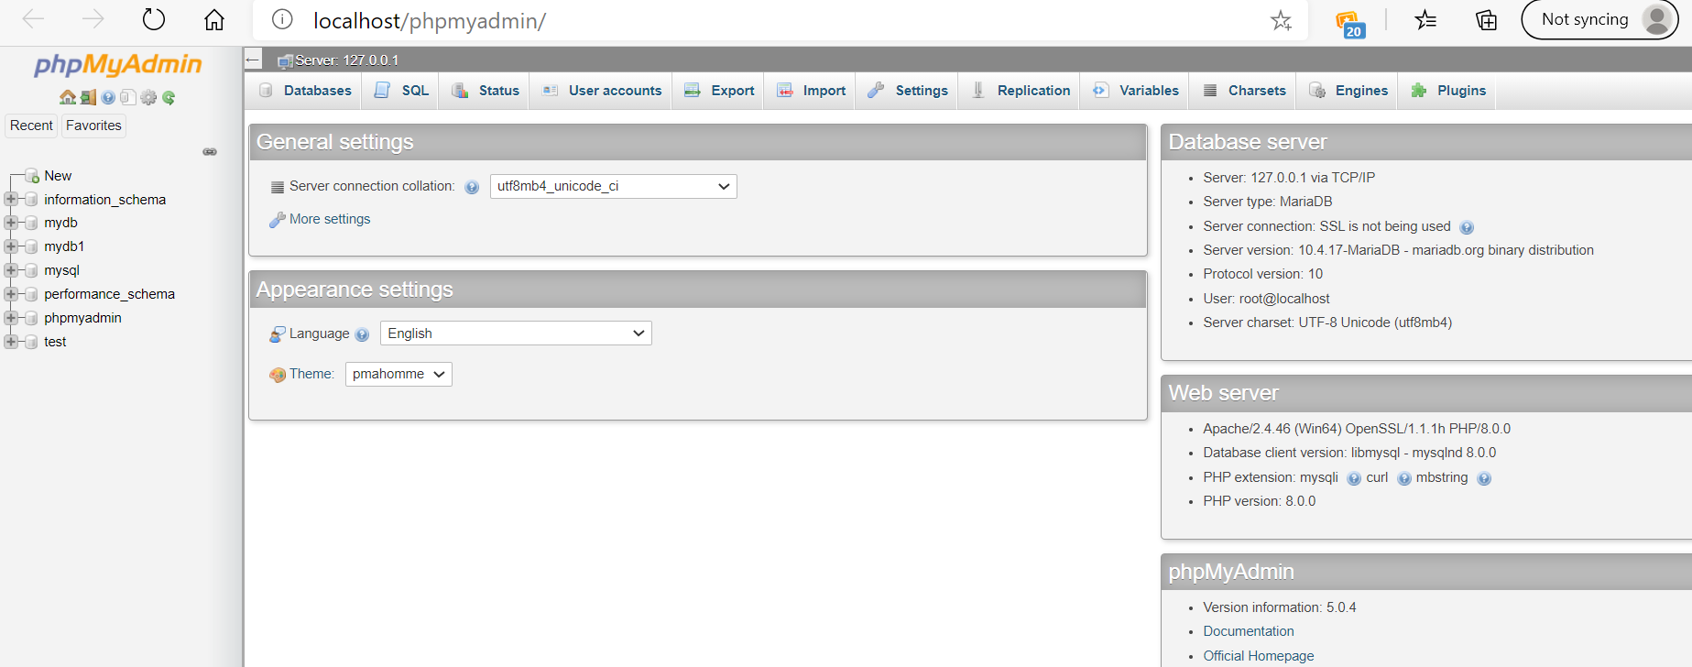
phpMyAdmin
phpMyAdmin is a free and open-source administration tool for MySQL

Slide 52
Connecting to Server (MySqli Procedural)
<?php
$servername = "localhost";
$username = "root";
$password = "";
// Create connection
$conn = mysqli_connect($servername, $username, $password);
// Check connection
if (!$conn) {
die("Connection failed: " . mysqli_connect_error());
}
echo "Connected successfully";
?>

Slide 53
Create Database
<?php
$servername = "localhost";
$username = "root";
$password = "”;
$dbname = “myDB”;
// Create connection
$conn = mysqli_connect($servername, $username, $password, $dbname);
//Create database
$sql = "CREATE DATABASE myDB";
if (mysqli_query($conn, $sql)) {
echo "Database created successfully";
} else {
echo "Error creating database: " . mysqli_error($conn);
}
mysqli_close($conn);
?>

Slide 54
Create Table
// sql to create table
$sql = "CREATE TABLE MyGuests (
id INT(6) UNSIGNED AUTO_INCREMENT PRIMARY KEY,
firstname VARCHAR(30) NOT NULL,
lastname VARCHAR(30) NOT NULL,
email VARCHAR(50),
reg_date TIMESTAMP DEFAULT CURRENT_TIMESTAMP ON UPDATE CURRENT_TIMESTAMP
)";
if (mysqli_query($conn, $sql)) {
echo "Table MyGuests created successfully";
} else {
echo "Error creating table: " . mysqli_error($conn);
}
mysqli_close($conn);
?>
<?php
$servername = "localhost";
$username = "root";
$password = "";
$dbname = "myDB";
// Create connection
$conn = mysqli_connect($servername, $username, $password, $dbname);
// Check connection
if (!$conn) {
die("Connection failed: " . mysqli_connect_error());
}

Slide 55
Create Table
The data type specifies what type of data the column can hold.
After the data type, you can specify other optional attributes for each column:
NOT NULL - Each row must contain a value for that column, null values are not allowed
DEFAULT value - Set a default value that is added when no other value is passed
UNSIGNED - Used for number types, limits the stored data to positive numbers and zero
AUTO INCREMENT - MySQL automatically increases the value of the field by 1 each time a new record is added
PRIMARY KEY - Used to uniquely identify the rows in a table. The column with PRIMARY KEY setting is often an ID number, and is often used with AUTO_INCREMENT

Slide 56
Insert Data Into MySQL Using MySQLi
After a database and a table have been created, we can start adding data in them.
Here are some syntax rules to follow:
The SQL query must be quoted in PHP
String values inside the SQL query must be quoted
Numeric values must not be quoted
The word NULL must not be quoted

Slide 57
Insert Data Into Table
The INSERT INTO statement is used to add new records to a MySQL table:
INSERT INTO table_name (column1, column2, column3,...)
VALUES (value1, value2, value3,...)

Slide 58
Insert Data Into Table
$sql = "INSERT INTO MyGuests (firstname, lastname, email)
VALUES ('John', 'Doe', 'john@example.com')";
if (mysqli_query($conn, $sql)) {
echo "New record created successfully";
} else {
echo "Error: " . $sql . "<br>" . mysqli_error($conn);
}
mysqli_close($conn);
?>
<?php
$servername = "localhost";
$username = "root";
$password = "";
$dbname = "myDB";
// Create connection
$conn = mysqli_connect($servername, $username, $password, $dbname);

Slide 59
Insert Multiple Entries
$sql = "INSERT INTO MyGuests (firstname, lastname, email)
VALUES ('John', 'Doe', 'john@example.com');";
$sql .= "INSERT INTO MyGuests (firstname, lastname, email)
VALUES ('Mary', 'Moe', 'mary@example.com');";
$sql .= "INSERT INTO MyGuests (firstname, lastname, email)
VALUES ('Julie', 'Dooley', 'julie@example.com')";
if (mysqli_multi_query($conn, $sql)) {
echo "New records created successfully";
} else {
echo "Error: " . $sql . "<br>" . mysqli_error($conn);
}
mysqli_close($conn);
?>
<?php
$servername = "localhost";
$username = "root";
$password = "";
$dbname = "myDB";
// Create connection
$conn = mysqli_connect($servername, $username, $password, $dbname);

Slide 60
Select Data
$sql = "SELECT id, firstname, lastname FROM MyGuests";
$result = mysqli_query($conn, $sql);
if (mysqli_num_rows($result) > 0) {
// output data of each row
while($row = mysqli_fetch_assoc($result)) {
echo "id: " . $row["id"]. " - Name: " . $row["firstname"]. " " . $row["lastname"]. "<br>";
}
} else {
echo "0 results";
}
mysqli_close($conn);
?>
<?php
$servername = "localhost";
$username = "root";
$password = "";
$dbname = "myDB";
// Create connection
$conn = mysqli_connect($servername, $username, $password, $dbname);

Slide 61
Filter Data
The WHERE clause is used to filter records.
The WHERE clause is used to extract only those records that fulfill a specified condition.
SELECT column_name(s) FROM table_name WHERE column_name operator value

Slide 62
Filter Data
$sql = "SELECT id, firstname, lastname FROM MyGuests WHERE lastname='Doe'";
$result = mysqli_query($conn, $sql);
if (mysqli_num_rows($result) > 0) {
// output data of each row
while($row = mysqli_fetch_assoc($result)) {
echo "id: " . $row["id"]. " - Name: " . $row["firstname"]. " " . $row["lastname"]. "<br>";
}
}
else {
echo "0 results";
}
mysqli_close($conn);
?>
<?php
$servername = "localhost";
$username = "root";
$password = "";
$dbname = "myDB";
// Create connection
$conn = mysqli_connect($servername, $username, $password, $dbname);

Slide 63
Update Data
The UPDATE statement is used to update existing records in a table:
UPDATE table_name SET column1=value, column2=value2,...
WHERE some_column=some_value

Slide 64
Update Data
$sql = "UPDATE MyGuests SET lastname='Doe' WHERE id=2";
if (mysqli_query($conn, $sql)) {
echo "Record updated successfully";
} else {
echo "Error updating record: " . mysqli_error($conn);
}
mysqli_close($conn);
?>
<?php
$servername = "localhost";
$username = "root";
$password = "";
$dbname = "myDB";
// Create connection
$conn = mysqli_connect($servername, $username, $password, $dbname);

Slide 65
Delete Data
The DELETE statement is used to delete records from a table:
DELETE FROM table_name WHERE some_column = some_value

Slide 66
Delete Data
$sql = "DELETE FROM MyGuests WHERE id=3";
if (mysqli_query($conn, $sql)) {
echo "Record deleted successfully";
} else {
echo "Error deleting record: " . mysqli_error($conn);
}
mysqli_close($conn);
?>
<?php
$servername = "localhost";
$username = "root";
$password = "";
$dbname = "myDB";
// Create connection
$conn = mysqli_connect($servername, $username, $password, $dbname);

Slide 67
Useful Videos
https://www.youtube.com/watch?v=OHjkg_rifTw
https://www.youtube.com/watch?v=WYufSGgaCZ8
https://www.youtube.com/watch?v=lGYixKGiY7Y
https://www.youtube.com/watch?v=dMxS-asCFgQ

Slide 68
Assignment 3
Web Development - Project 2
50% weightage
10 min demonstration by each student in Week 12
Plan your demonstration. Practice few times before Presentation day
Zero marks if you are absent
Students will be asked questions about their development after presentation.

Slide 69
Any Questions?

